Slide 1
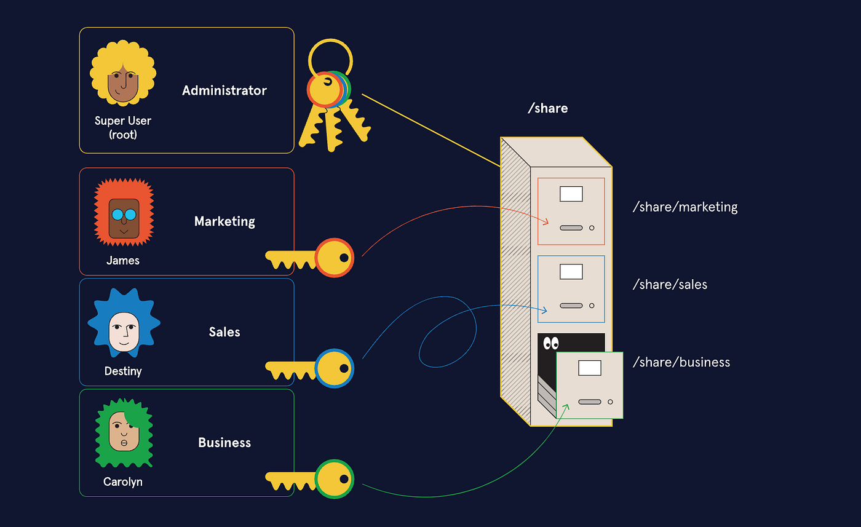
Linux User Account Automation
Team Alton - Alton Matovu
CS 386 — Fall 2025 — Instructor: Varik

Slide 2
Outline
Background
System Architecture
Automation Workflow (Sequence)
System Entities and Relationships
Live Demo
Challenges/Future Implementations
01

Slide 3




Background
Linux(Operating System)
• Bash scripting
• SSH key-based login
CSV Input Data
Apache Web Server
02

Slide 4
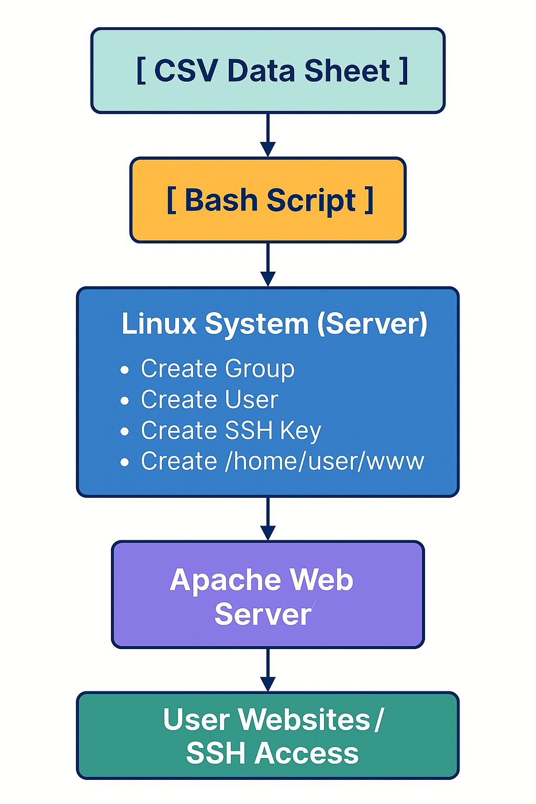
System Architecture
03

Slide 5
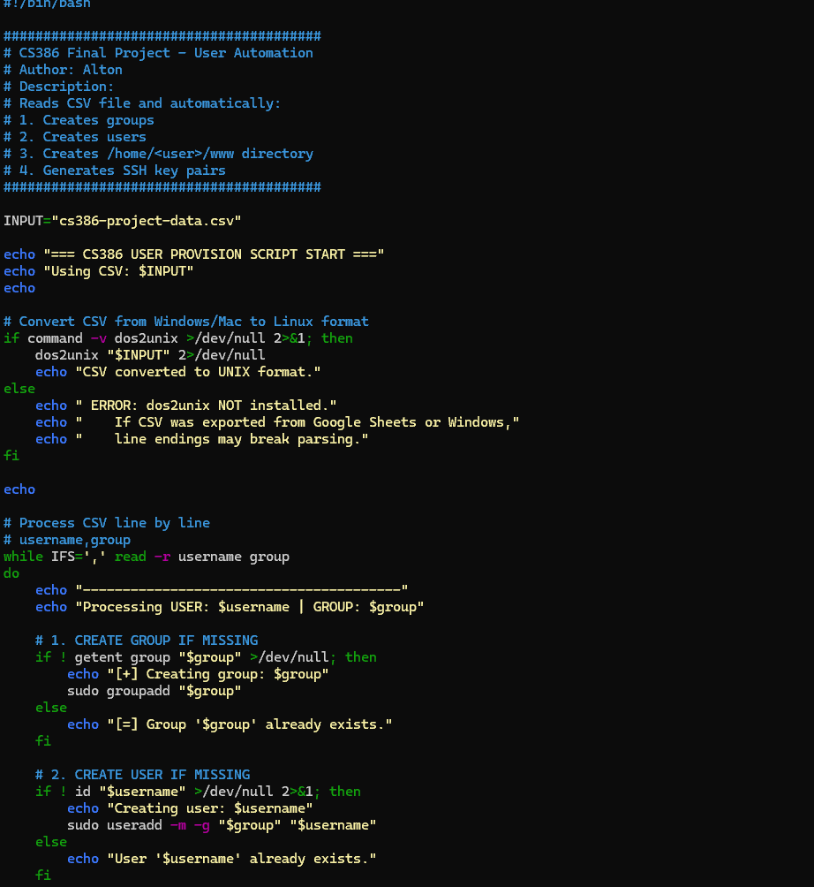
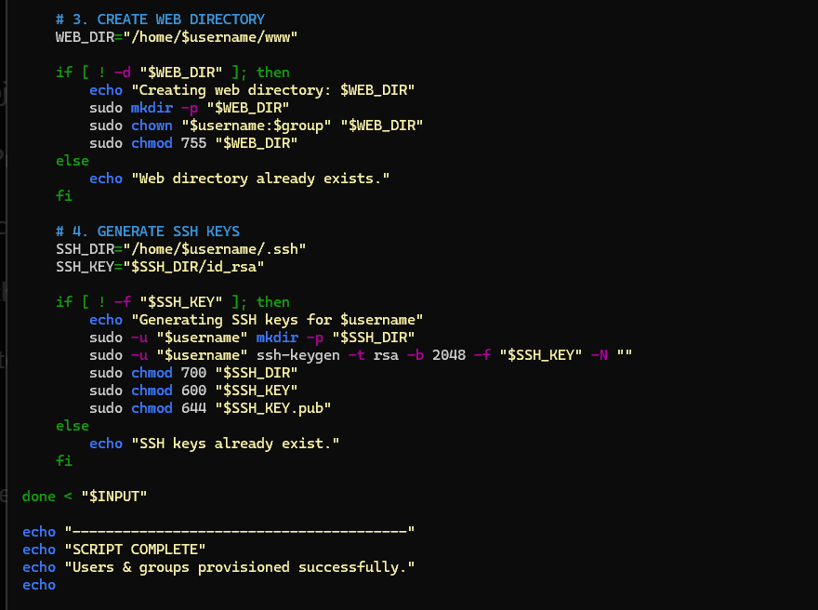
Automation WorkFlow
1.Script reads user information from CSV
2.Creates Linux groups if they do not exist
3.Provisions new user accounts
4. Creates home and website directories
5.Generates SSH keys automatically
6.Reports success
04

Slide 6
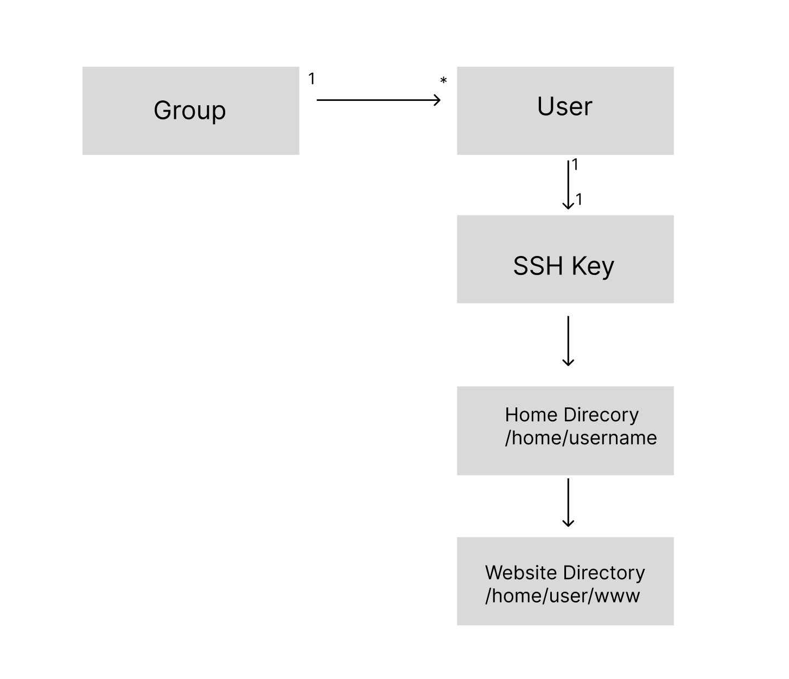
System Entities and Relationships
05

Slide 7
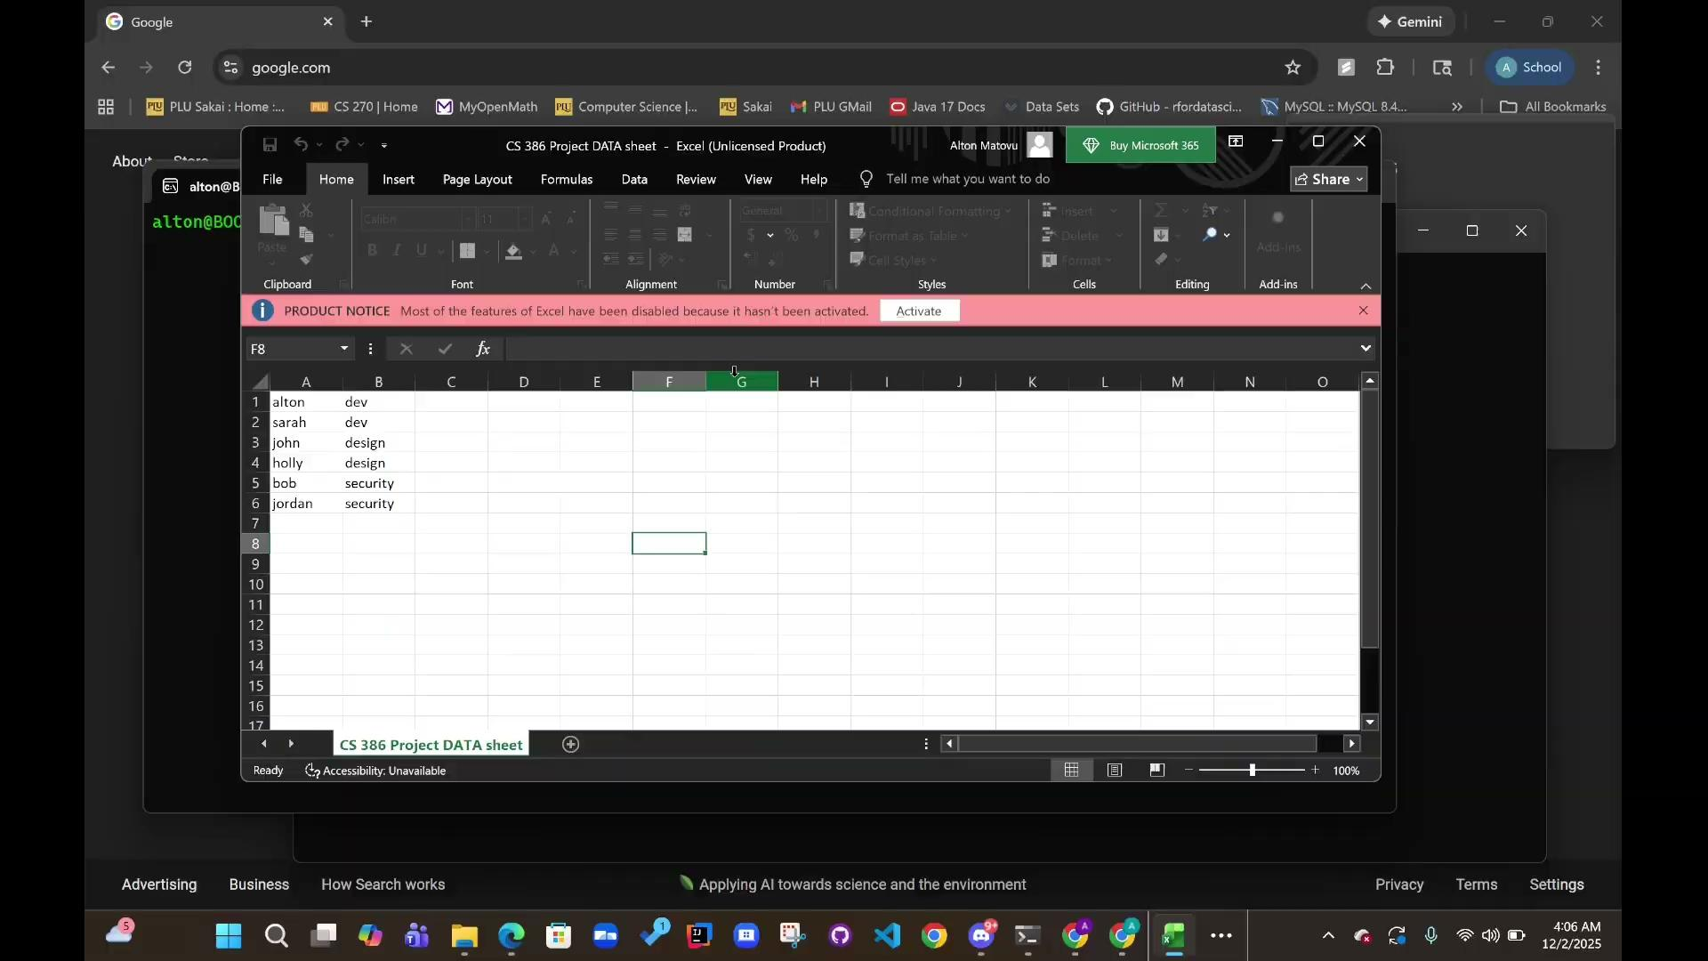
Live Demo
06

Slide 8

Challenges/Future Implementations
Converting CSV files from Google Sheets to Linux format (CRLF vs LF)
Debugging and testing script
Add a monitoring system
User being able to work in their own websites
07

Slide 9
References
Apache Software Foundation. (n.d.). Apache HTTP Server Documentation.
https://httpd.apache.org/docs/
GNU Project. (n.d.). Bash Reference Manual. Free Software Foundation.
https://www.gnu.org/software/bash/manual/bash.html
OpenBSD Project. (n.d.). OpenSSH: Secure Shell Protocol.
https://www.openssh.com/
Red Hat, Inc. (2023). Using Shell Scripts for System Administration.
https://access.redhat.com/documentation/
GitHub. (2024). User Management Automation Script Example Repository.
https://github.com/robertdebock/ansible-role-users
Images:
https://www.istockphoto.com/photos/carrying-boulder
https://medium.com/@npranto/quick-bite-ssh-key-5a8e56cea0b7
https://freebiesupply.com/logos/linux-tux-logo-2/
https://www.flaticon.com/free-icon/csv_8242984
https://commons.wikimedia.org/wiki/File:Apache_HTTP_server_logo_(2019-present).svg
https://medium.com/@jasurbek.go.dev/users-groups-and-permissions-in-linux-1fa6d56b744a
08

Slide 10

Thank you!
Feel free to ask any questions

